Slide 1
SustainOSS and University OSPOs
Richard Littauer
Notes:
Tēnā koutou e ngā mana whenua, e ngā karangatanga maha o te wāhi nei.

Slide 2

What is SustainOSS?
A community of people trying to figure out how to keep OSS sustainable
Conferences
Working groups
Podcasts

Slide 3
Where sustainability applies in FOSS:
Projects
Developers
Communities
Businesses
Academia
Ecosystems
Environment
Notes:
Let's go over these in depth, to see how it is applied.

Slide 4
Sustain: FOSS Projects
Growth
  More in than out
  Pathways to maintainer
  Product management and design planning
  Goal: capturing market share of attention

Slide 5
Sustain: FOSS Projects
Diversity
  Welcoming community spaces
  CoCs
  Documentation
  Moderation
  Mentoring
  Goal: towards some ethical destination

Slide 6
Sustain: FOSS Projects
Funding
  Funding for the project costs
  Funding for the core maintainers
  Lifestyle funding
  Funding for all contributors
  Non-fiscal sponsorships

Slide 7
Sustain: FOSS Developers
Satisfaction
Career trajectories
Mentoring
Funds and recognition
Avoiding burnout

Slide 8
Sustain: FOSS Communities
Not always tied to a project
Functionally similar to what we talked about above

Slide 9
Sustain: FOSS Businesses and Corporate
Focus: a bottom line
Not pushing OSS onto your employee's private time
Having advocates and marketing inside the company for open source
OSPOs
"Collaboration"

Slide 10
Sustain: FOSS Impact
€65 to €95 billion to the European Union’s GDP (OFE)
2024: The Value of Open Source Software by Manuel Hoffmann, Frank Nagle, Yanuo Zhou
  Supply-side value (cost to re-create) is $4.15bn
  Demand-side (usage) value is $8.8tr
  Firms would need to spend 3.5 times more on software than currently, if OSS did not exist

Slide 11
Sustain: FOSS Ecosystem
Funding maintainers for their work
Security and supply chains
The "digital commons"

Slide 12
Sustain: FOSS Ecosystem
Legal sustainability and licenses
  Stopping proliferation
  Open washing
  Patent issues
AI + open source
Taxation and infrastructural funding
The CRA and their ilk

Slide 13
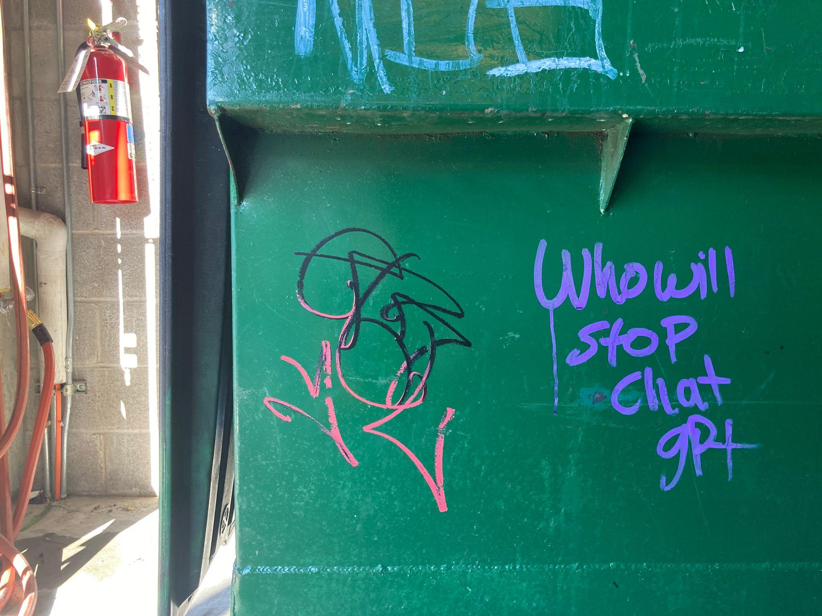
Sustain: FOSS Ecosystem

Slide 14
Sustain: FOSS & Environment
Open source hardware
Carbon-neutral data storage centers
Reducing server costs
Not using bitcoin
Avoiding the conference trap

Slide 15
Sustain: FOSS & the whole environment
Tech for environmental activists
Tech for environmental studies
Use of tech for the planet as a whole

Slide 16
Sustain Academic Working Group
Monthly meetings
25~ average attendance
Mailing list, etc.

Slide 17
Sustain Academia:
Monthly meetings
25~ average attendance
Mailing list, etc.

Slide 18
Software as a dependency
Research software
Underlying open source infrastructure
Risks:
Invisible dependencies are underfunded, undercited, and well… invisible

Slide 19
Research Software
Research software as a first-order object
Not recognized in the formal academic process for tenure, etc.
Not recognized as a research object
Generally undersupported
ReSA is working on this

Slide 20
Teaching material
Open source as course content
At least one course at JHU
A Masters at Brandeis
Generally rare
Could foster collaboration

Slide 21
Edtech
OSS used by the institution itself
Researchers often expected to know about this and be able to talk about it fluently, without being supported

Slide 22
University spin-outs
Commercialization of open source directly, often through hacklabs or IT departments that independently supported students
Can involve direct collaboration (CROSS)
Should be brought up to CRIs

Slide 23
Academia to Business collaborations
Akamai, open source MIT project to public company
SAP and Alliander working with academics on paid collaborations
CROSS

Slide 24
OSS as a research subject
1000s of papers on Open Source
Can inform policy around OSS
Related to software preservation
Can influence OSS directly - Michigan and the Linux kernal

Slide 25
OSS as a research object
Part of a university's overall research output
Citation File Format
Zenodo DOIs
JOSS
Should be bundled with data

Slide 26
OSS as a target for funding
Rhetoric around OSS and collaboration influence the funding landscape
Philanthropy: Sloan, Ford, Etc
Government: "Year of Open Science", NIH directorates
Non-profits: ROpenSci, NumFOCUS, ReSA
Communities: SustainOSS, OSC

Slide 27
Other OSS venn diagrams
"Open" work
Security
Sovereignity
Reproducibility
Maintainer cycles

Slide 28
Supporting OSS in Academia: OSPOs
Open Source Program Office
Started at JHU, RIT, CROSS
10+ universities
CURIOSS

Slide 29

















Academic OSPOS

Slide 30
University OSPOs
Goals & Activities
OSS Excellence
OSS Best Practices in university context
OSS License Guidance
Research Impact
Working with Technology Transfer Offices
Working with communities
Skills & Education
Supporting OSS skills in curricula
Internship Programs
University Operations
OSPO Operations
Guidance on OSS Tools & Infrastructure

Slide 31
What next?
Join us?
Or… questions?
Tēnā koutou katoa.

